Slide 1

The Optimal Location For Opening A Chinese Restaurant In Toronto
Xianan Zhang

Slide 2


Compare Potential Benefit(s) and Risk(s)
Great competition pressure from local restaurants especially in areas such as downtown Toronto
Lack of customers if the restaurant is situated in a quiet district
Competition from other Chinese restaurants
Why Toronto & Why Chinese Restaurant?
Toronto, which is one of the most beautiful and multicultural cities in Canada, attracts a lot of immigrants from different countries around the world every year.
Chinese make up a great proportion of the entire immigrant population.
Chinese cuisine has become one of the most popular food categories in the world today
What Might Be The Potential Risk?

Slide 3

Data
The List of Post codes of Canada from the Wikipedia page https://en.wikipedia.org/wiki/List_of_postal_codes_of_Canada:_M. This dataset contains postal codes, names and the neighborhoods of each borough of the Toronto city;
The geographical dataset downloaded from the link http://cocl.us/Geospatial_data which contains useful geographical coordinates of each postal code;
The dataset of the demographics of Toronto from the Wikipedia page https://en.m.wikipedia.org/wiki/Demographics_of_Toronto#Ethnic_diversity provides useful information of the population composition of each borough and neighborhood within the Toronto city;
The Foursquare’s API is used to explore nearby venues of any specific location within the Toronto city. The endpoints that I am going to use from the Foursquare’s API include the name, category, latitude as well as longitude of each venue explored.

Slide 4

Data Cleaning and Pre-Processing
Merge tables of ‘The List of Post codes of Canada’ and ‘Geospatial data’
Scrape relevant table from the wiki page of “Demographics of Toronto’
Use Foursquare’s API to explore all nearby venues within the 1km radius of each neighborhood in Toronto

Slide 5
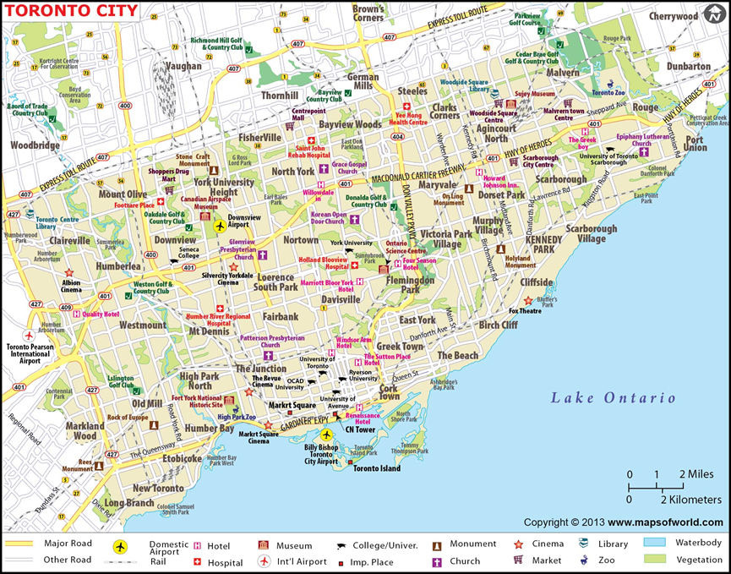
Map of Toronto City
Source: Maps of World https://www.mapsofworld.com/canada/toronto-map.html

Slide 6
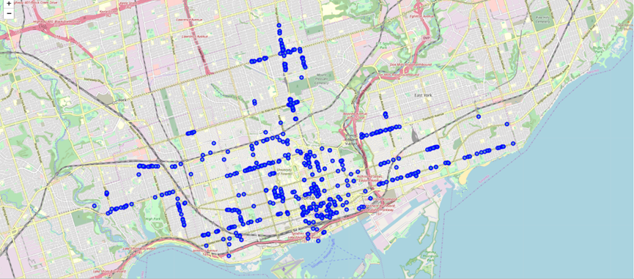
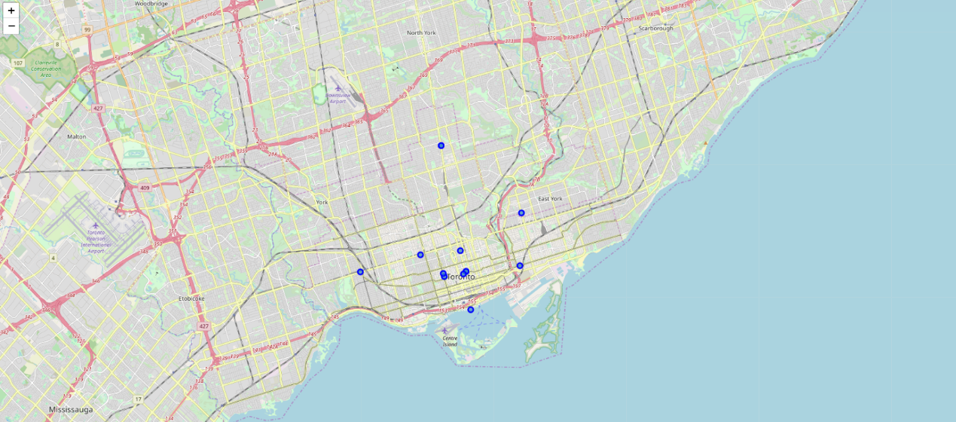
Restaurants within the 1km Radius of each Neighborhood of Toronto
Restaurants are located densely in the central area of Toronto but much less densely in surrounding areas.
Areas such as East York, Cork Town and the Junction have a great number of restaurants.
The density of restaurants in surrounding areas is much lower relative to the density of central areas.
There are just a few Chinese Restaurants near the center of each neighborhood.
All Restaurants
Chinese Restaurants

Slide 7
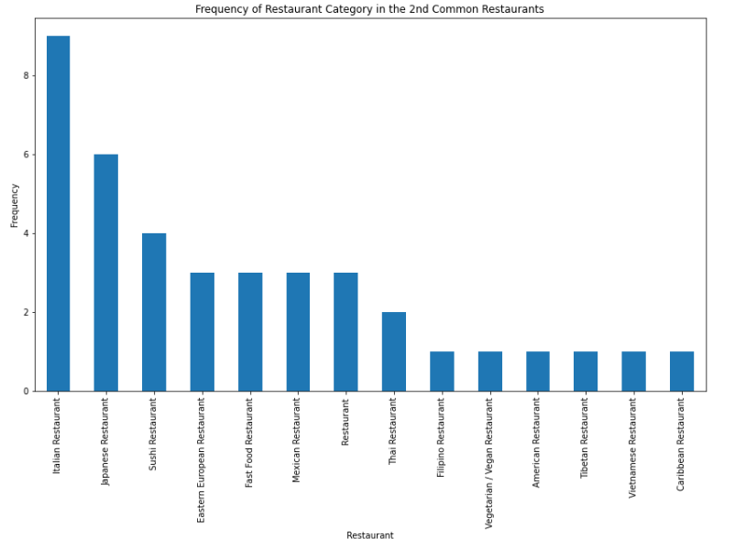
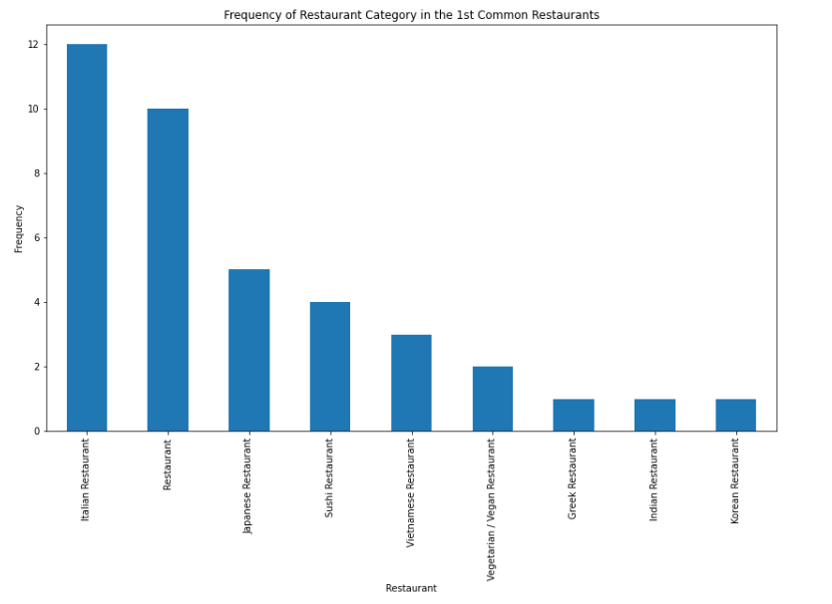
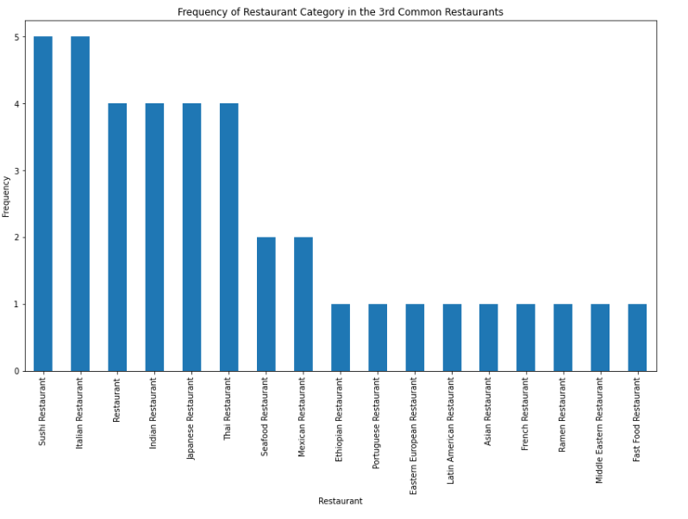
The Frequency of Restaurant Category in the 1st, 2nd, and 3rd Most Common Restaurant Categories Among All Neighborhoods

Slide 8
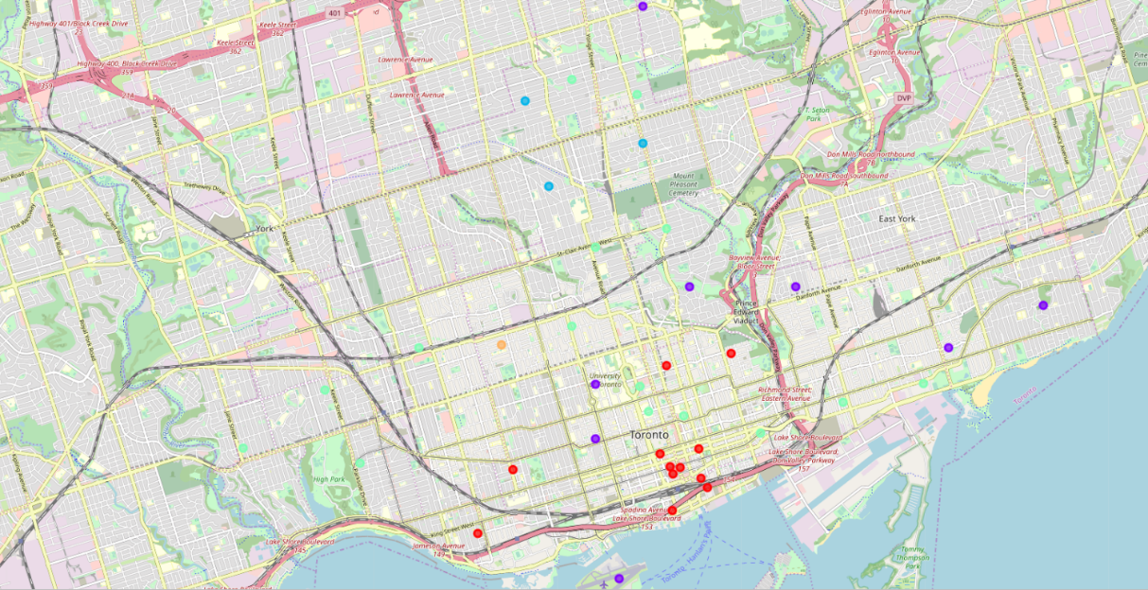
Clustered Neighborhoods Based on Restaurant Categories
Sushi Restaurant
Vietnamese, Vegetarian/Vegan and Japanese
Italian Restaurant
Other
General Restaurant

Slide 9
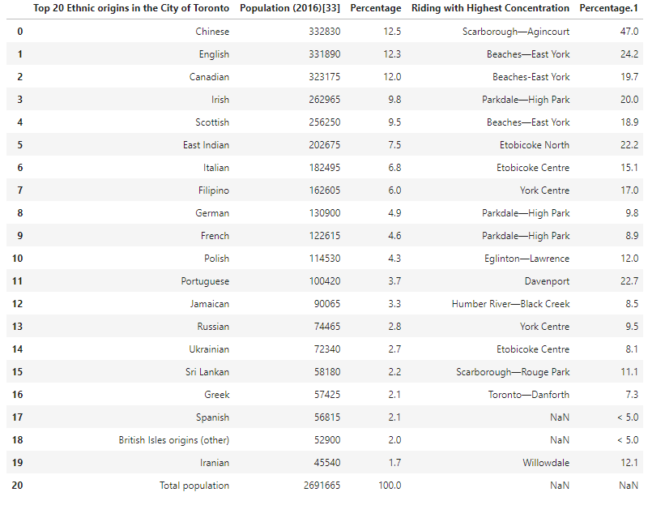
Population Density Analysis
The Chinese group with a population of 332,830 accounts for approximately 12.5% of the overall population of Toronto city.
The size of the Chinese ethic origin even exceeds the English origin, which only make up 12.3% of the total population of Toronto.
The riding with the highest Chinese concentration is Scarborough-Agincourt where over 47% of the local population is made up of Chinese.

Slide 10
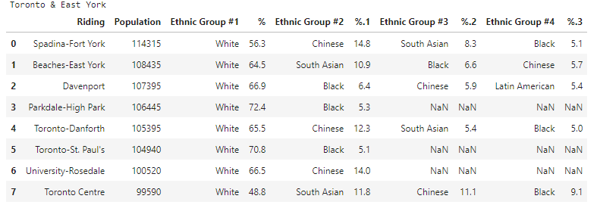
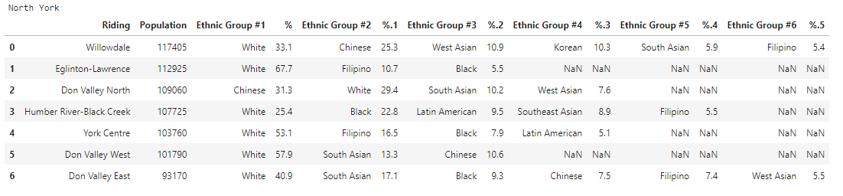
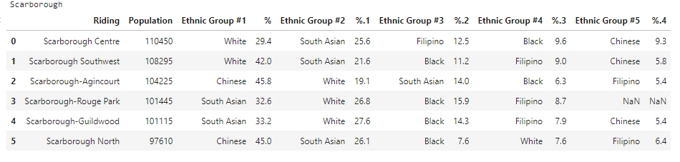
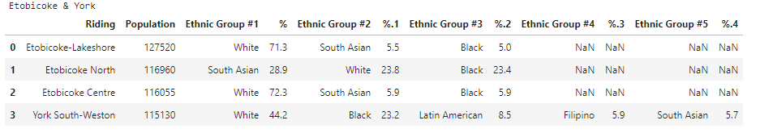
Population Distribution of Individual Boroughs

Slide 11

Conclusion
Opening a new Chinese restaurant in Toronto is a good opportunity
Chinese restaurants are not very common in this city indicating less severe competition pressure from peer members
Districts such as Scarborough have a great number of Chinese residents providing good customer base for a new restaurant.

